Slide 1
Annual Service Complaints Report 2021-22
A summary of our performance against the Model Complaints Handling Procedure

Slide 2
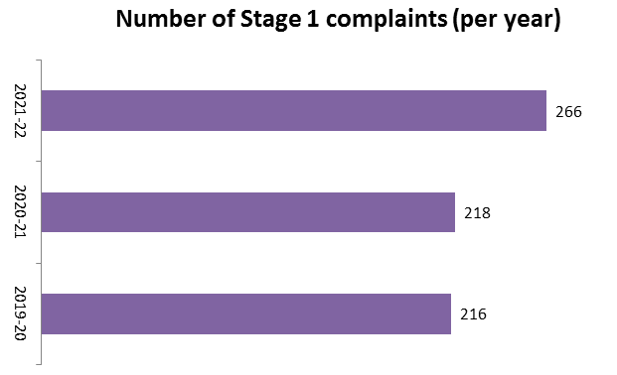
Stage 1 Complaints
A complaint is logged every time a customer expresses dissatisfaction about something that should have happened that has not happened or complains about the quality of our services.
Our two stage complaints process is the same as the one followed by every Housing Association and public service in Scotland.
The aim of the complaint procedure is to resolve issues as quickly as possible and within 5 working days.
The picture shows that there was an increase in the number of complaints received in 2021-22 compared to the previous two years. This increase is partly due to delays in our repairs service caused by the Covid-19 pandemic.

Slide 3
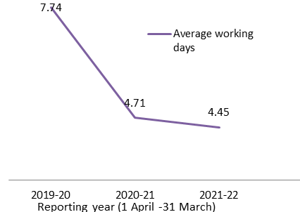
Stage 1 Complaints
Graph: Performance against target
In most cases our staff resolve complaints within the 5 working day target timescale. There are some situations where this is not possible. Most commonly these are related to:
problems contacting customers to discuss the complaint; or
staff / contractor availability if certain people are needed to find out more information
We can extend complaints for a further 5 working days. This impacts our performance against timescales.
Where a complaint is too complex or too serious for stage one, it will be investigated at stage two of the process.
Performance for 2021-22 is 4.45 days which is within target. There has been improvement over time, showing the priority that staff give to resolving issues reported by customers.
Average performance in Scotland for this indicator during 2021-22 is 5.76 days

Slide 4
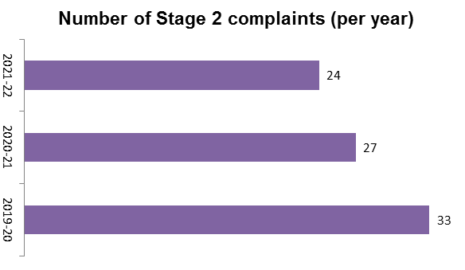
Stage 2 Complaints
Stage 2 complaints are logged when:
The customer is not satisfied with the response at Stage 1
The complaint is complex, and will take longer than 5 working days
The matter is serious, for example involving a threat to customer safety, or criminal behaviour,
Stage two responses represent the full and final answer from the Association.
If customers are not happy with the response at this stage, they can refer the complaint to the Scottish Public Services Ombudsman. We provide their contact details in our written response.
The picture shows that there was an decrease in the number of complaints received in 2021-22 compared to the previous two years.

Slide 5
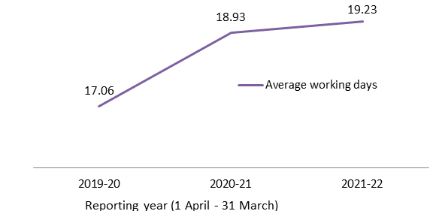
Stage 2 Complaints
Graph: Performance against target
It is extremely rare to find a Stage 2 case that has not been resolved within the 20-working day target.
These cases are investigated by senior staff who provide a written response. This outcome is checked and authorised by staff at the most senior leadership level, because it is our fully considered and final response to the complaint.
If a customer is still unhappy after they have received our Stage 2 response, we refer them to the Scottish Public Services Ombudsman Service.
Performance for 2021-22 is 19.23 days which is within target. There has been a gradual increase in the time taken to resolve these complaints over the three years.
This is mainly due to a prolonged period of being short staffed in our Property Team. This has now been resolved following successful recruitment.
Average performance in Scotland for this indicator during 2021-22 is 27.44 days.

Slide 6
Learning from Complaints
One of the most important parts of the complaints process is that we can demonstrate that we are learning from the complaints that we handle and prevent issues from repeating themselves.
We want our customers to get the best possible service, and we want our staff to continually make improvements to design out problems as much as possible. Mistakes will still happen; we are only human! But we review complaints with a view to implementing change for the better.
Every three months, our teams review all the complaints and set tasks that will create improvement. These are added to an action list that we use to report progress onwards to our Leadership Team, Board of Management, and our customers.
Please use the link to access the current Complaints Action List for 2021-22

